Slide 1
“CHILDREN ACTING FOR WELLBEING IN AN OPEN-SCHOOL” CONFERENCE
Primary teacher: Lucija Škvarča
School librarian: Mirjam Francetič
13MARCH, VENISSIEUX, FRANCE 2024

Slide 2
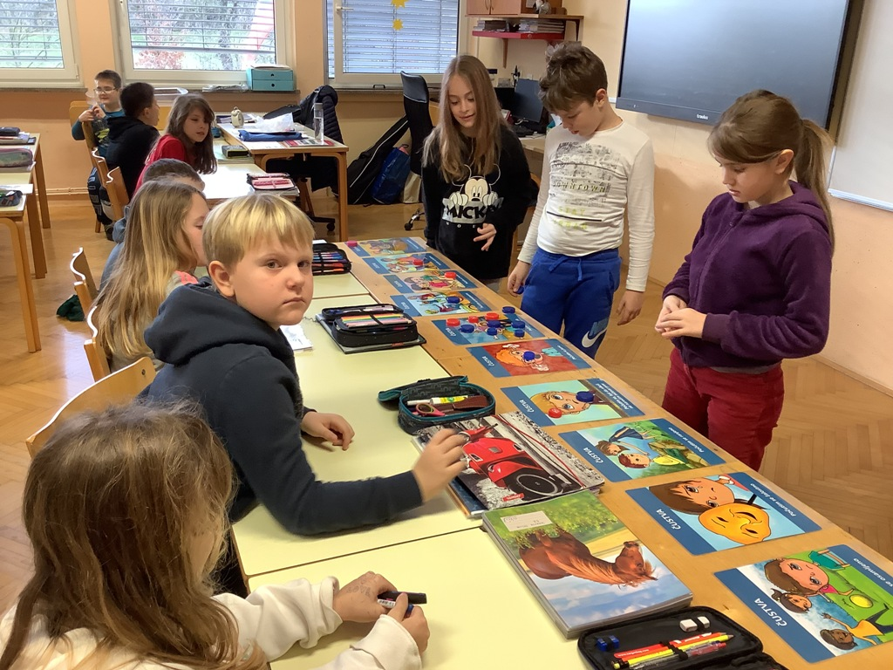
Students had to put a plastic cap on one of the Friendship cards.

Slide 3
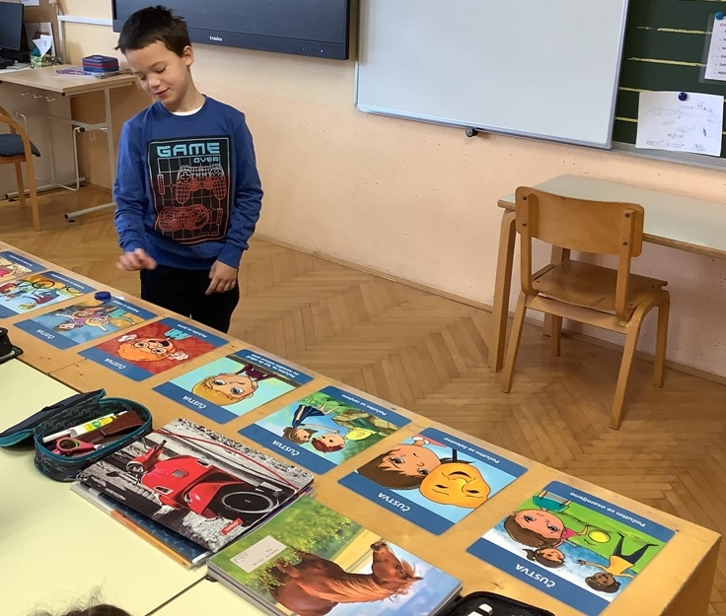
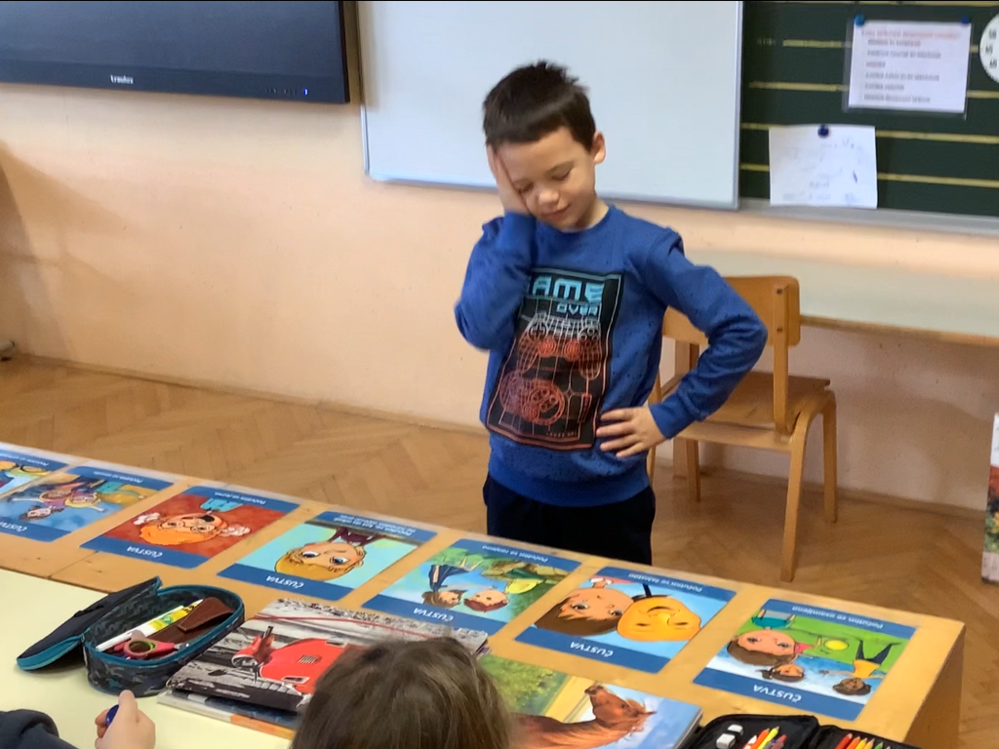
2. I'm happy. Am I?
1. How do I feel now?

Slide 4
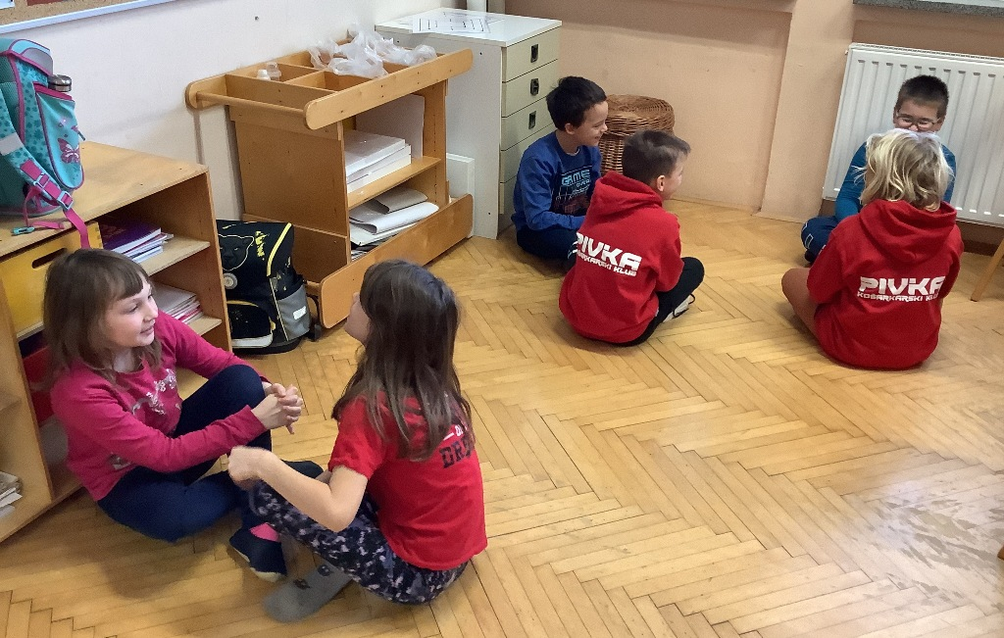
Students talk about how they feel at the moment.

Slide 5
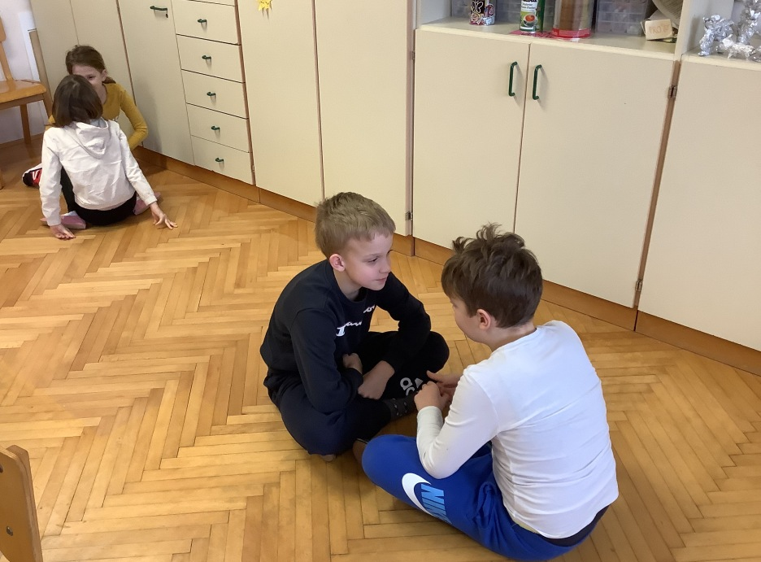
Why do they feel that way? How do they show it?

Slide 6
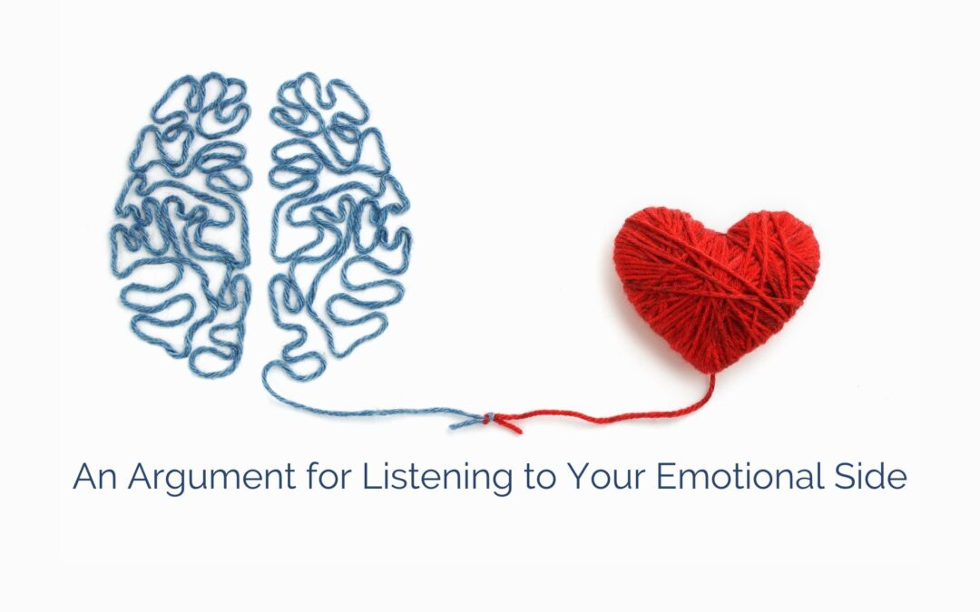
How do I feel when I'm happy, angry ... ?
What words and behaviors do I use to express this?
How can I help to someone who is sad, angry … ?

Slide 7
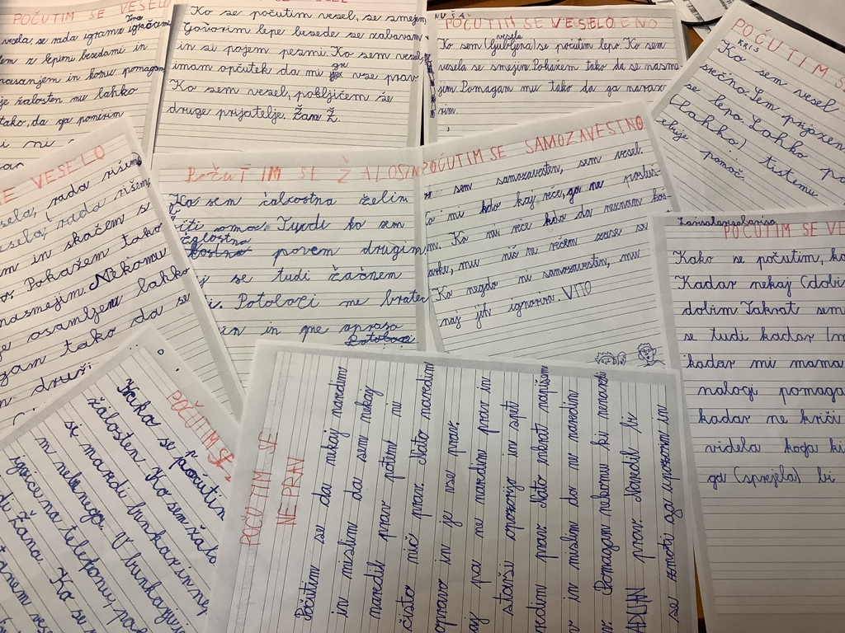
They wrote down their ideas.

Slide 8
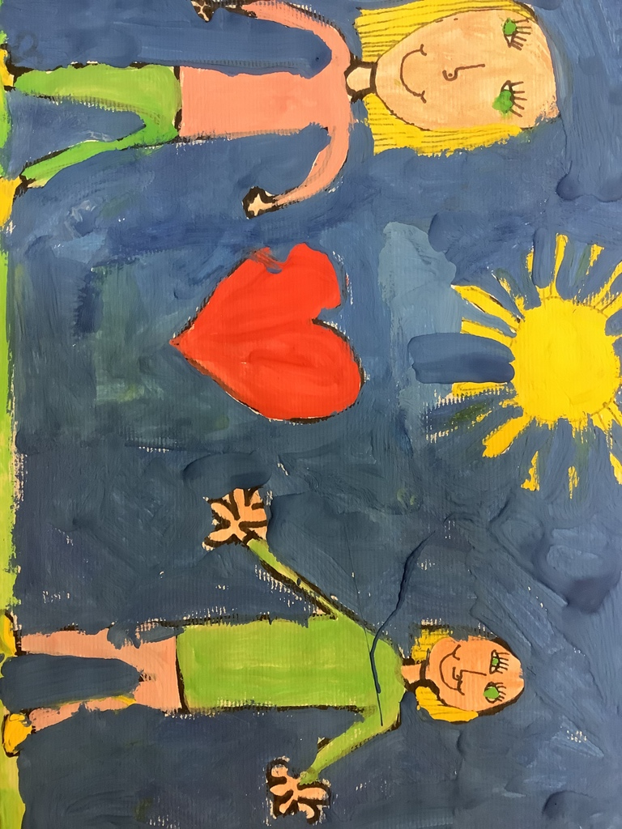
I feel loved When I am loved, I feel happy. I like this feeling because you always have someone there to help you and to love you. For those, who are not loved - I would help them by changing their appearance a little and make them look more beautiful. Nataša

Slide 9
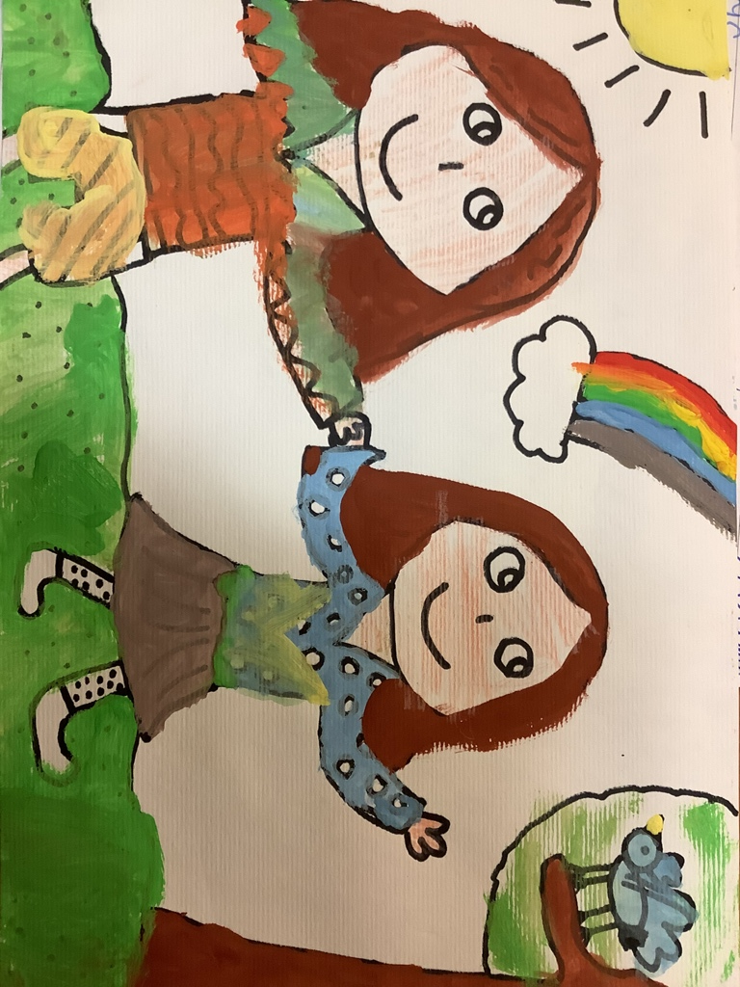
I feel happy When I know I am loved, I feel happy. When I am happy, I like to help others. I’m very happy today and I don’t want anything to ruin my day. I help others by talking to them. When I need help, I know my friend will help me. Rozi

Slide 10
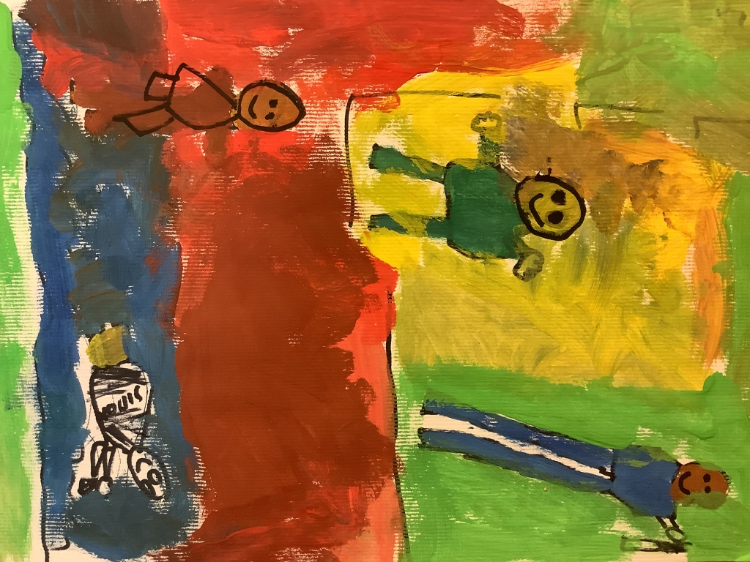
I'm happy When I'm happy, I have a smile on my face and I jump around. I am the happiest person when I receive a gift. I am happy when I help someone and when my teacher praises me. I am happy when I play with my friends and when I play with my mom and dad.
Nik
I´m happy
When I am happy, my heart beats faster. I have a smiling face. If anyone needs my help, I like to help them. If someone is sad, I ask them what happened and if I can help them.
Miha

Slide 11
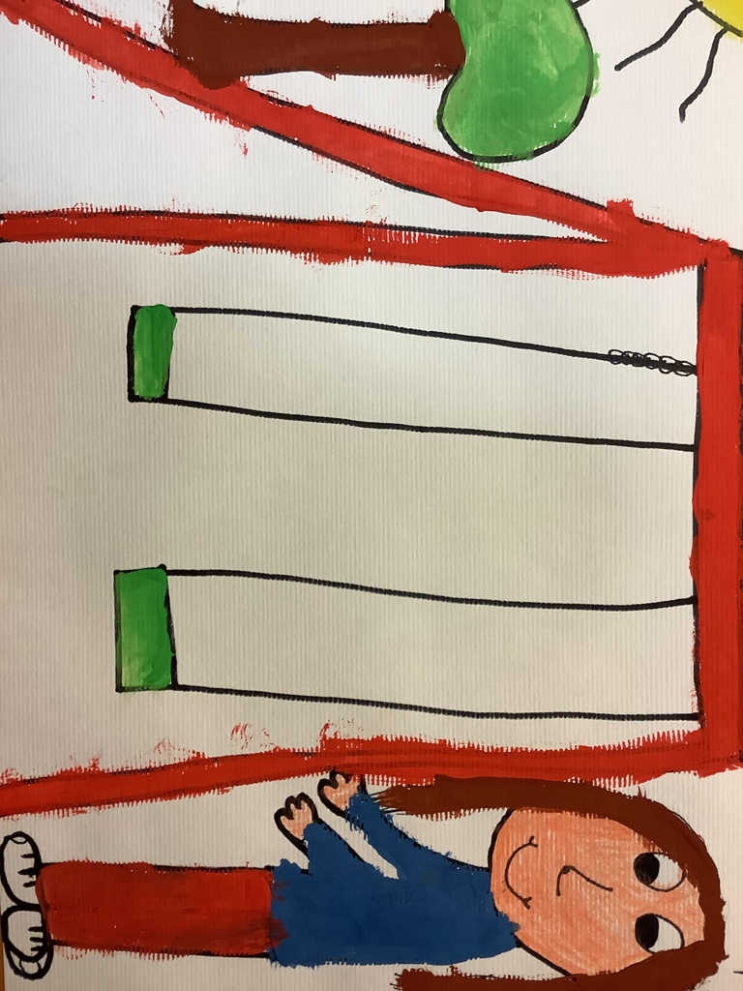
I feel lonely When I feel lonely, I want to go to my room and cover myself with a blanket. When I feel like this, I don’t say anything, I just keep quiet. When I am alone, I feel good. I can help someone who is not popular with others. Nina

Slide 12
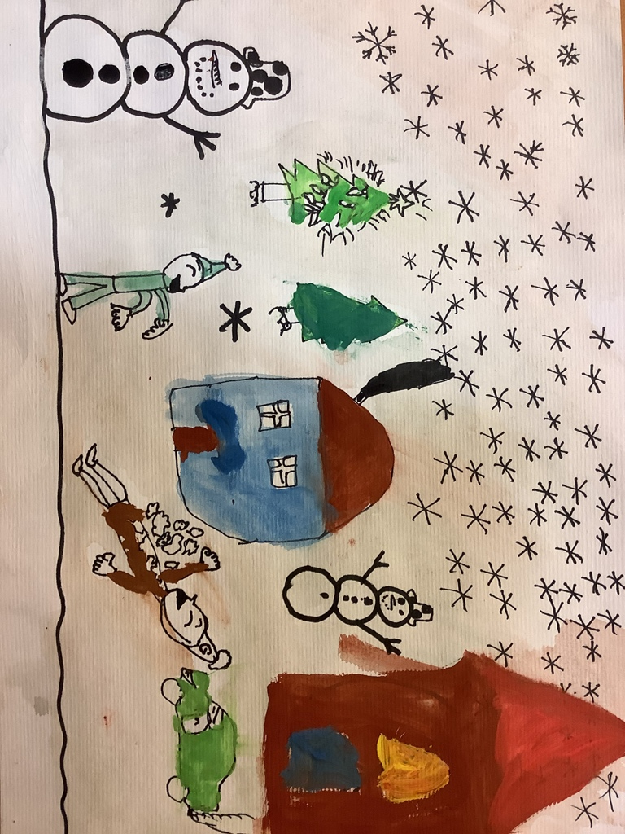
I'm not doing anything right
I feel like I'm not doing anything right. When I do something, I think I’m doing the right thing, and then it’s not right. My parents keep telling me I'm not doing anything right. Even when I try a lot, I do wrong.
Ivan

Slide 13
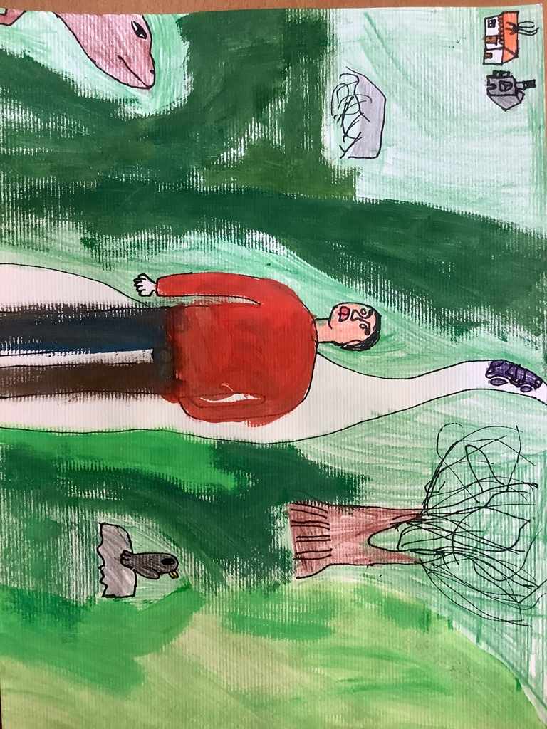
I feel sad When I'm sad, I make a bunker out of blankets and I don't listen to anyone. I'm in the bunker playing games on my phone. I call my friend. When I calm down and I feel happy, I go watch TV with my dad.
Tom

Slide 14
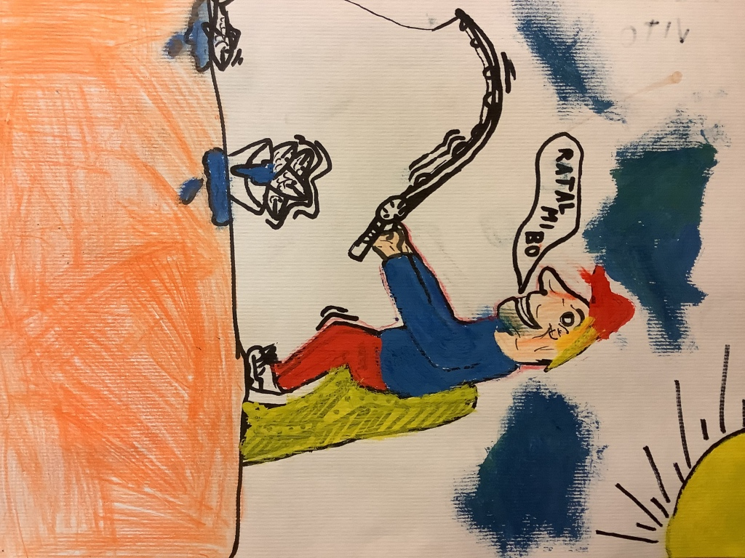
I feel confident When I am confident, I am happy. When someone tells me, that I don’t know something, I don’t listen. I'm good enough for myself. If someone is not confident, I advise them, to ignore others.
Matej

Slide 15
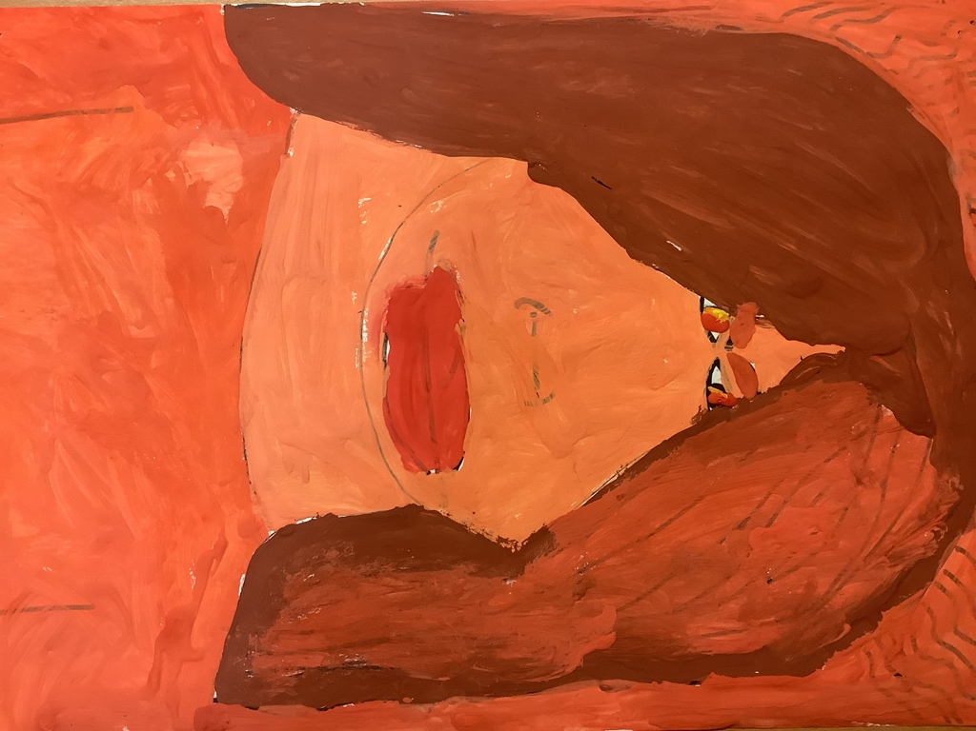
I am sad When I’m sad, I tell others I’m sad and that I want to be alone. Sometimes I cry too. I am comforted by my brother who asks me why I cry. Then we'll go play together.
Urška
I'm angry When I'm angry, I think bad things. When I'm angry, I don't tell anybody that I am angry. Everyone can see that I'm angry.
Aleš

Slide 16
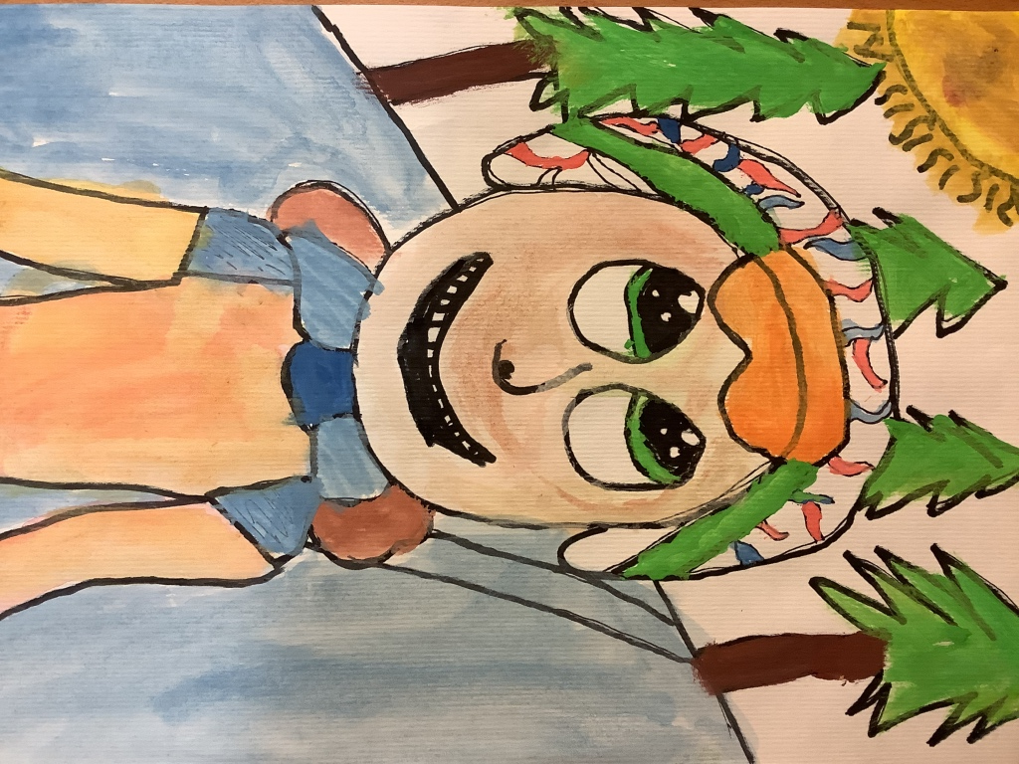
I am happy When I am happy, I laugh. I say nice words, I say „thank you“, and I sing songs. When I’m happy, I feel like everything is going well. When I’m happy, I call other friends. Anže
I'm happy When I am in a good mood, I feel happy. I'm kind to the others. I'm behaving well. I can help anyone who needs help. Bor

Slide 17
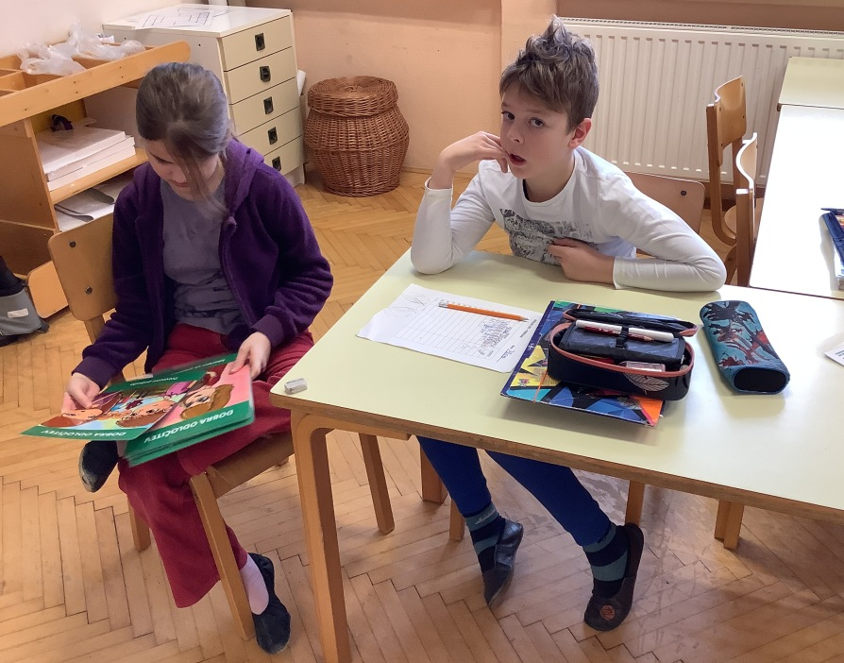
We use Friendship cards to cope with loneliness.

Slide 18
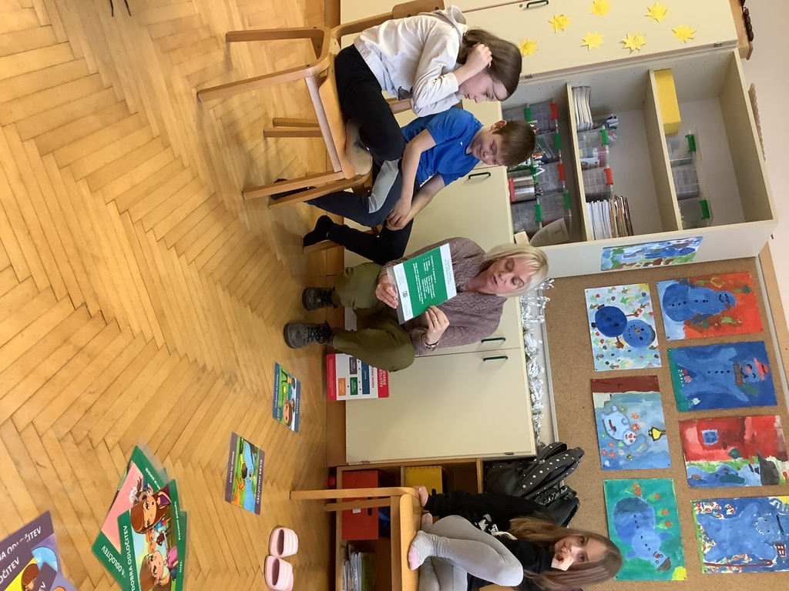
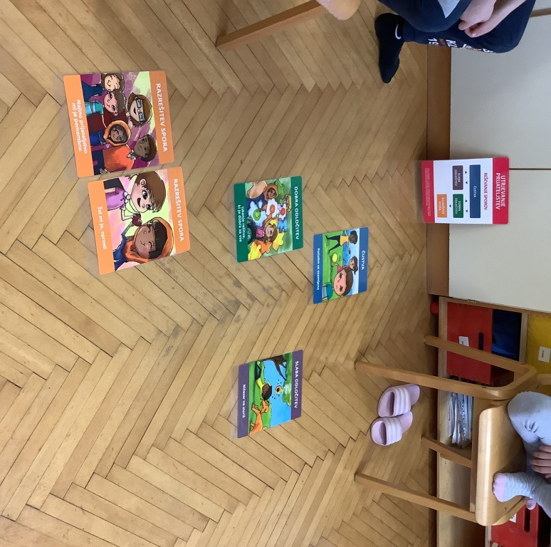
What can I do when I feel lonely? What can others do?

Slide 19
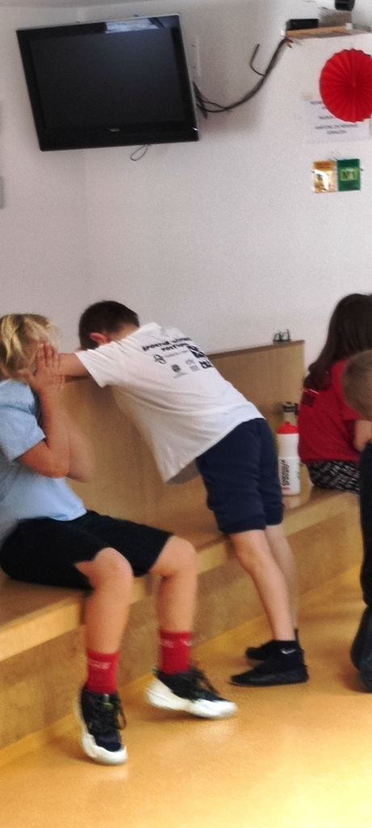
Our everyday life at school…
Stubbornes.
Anger.
Finding the culprit/guilt “outside” themselves.

Slide 20
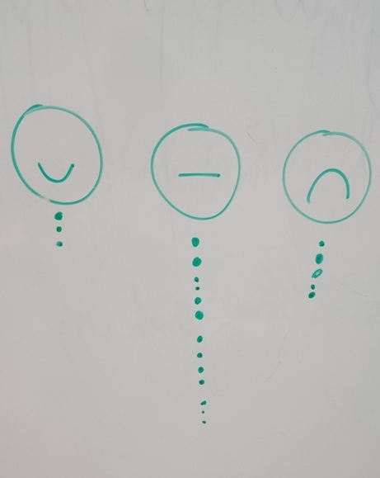
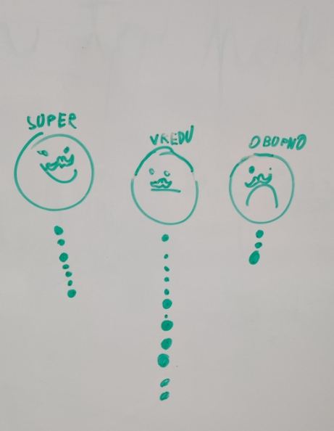
Semaphore of emotions
End of school day: How successful have I been at school today?
Morning: How do I feel?

Slide 21
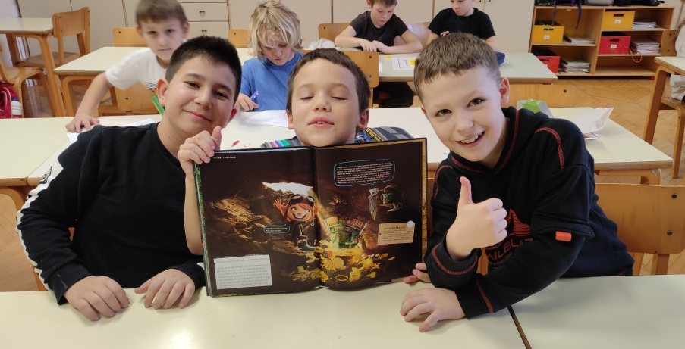
Collecting and exchanging images - stickers.

Slide 22
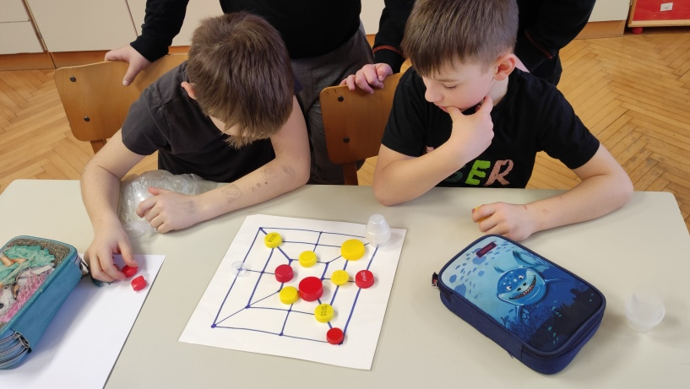
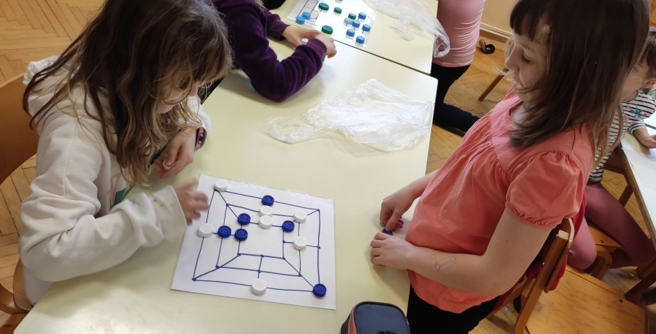
Playing the game Mill!

Slide 23
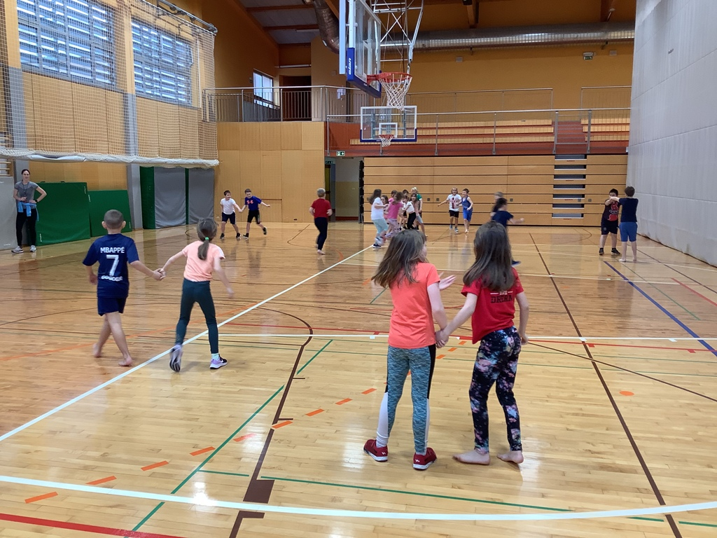
Students are very afraid to be rejected. Everyone wants to have a best friend – to be sure not to get rejected.
Activity: Hunting in a Couple - choose a classmate you’ve never held his hand before.
Talk!

Slide 24
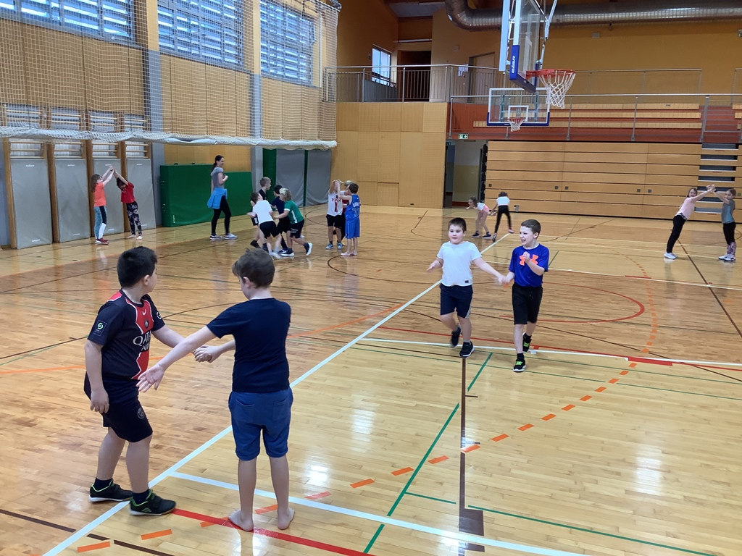
Collaboration!

Slide 25
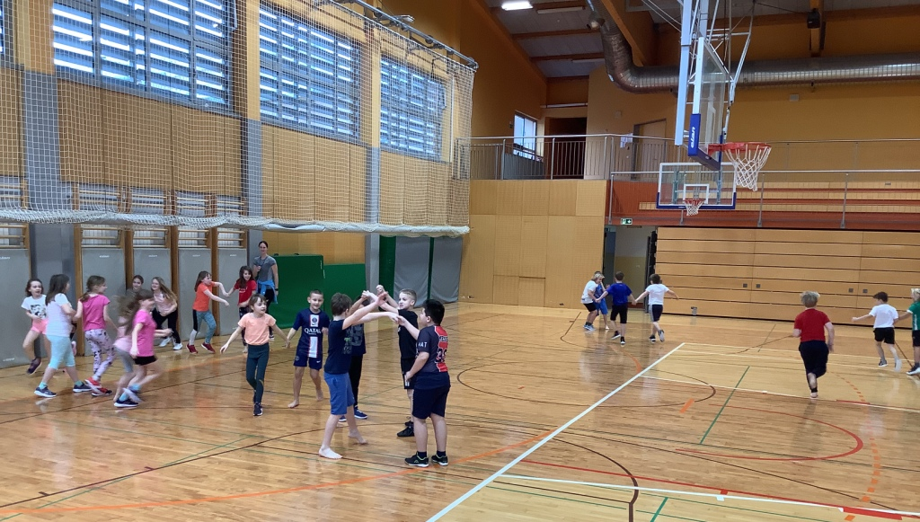
“That was so much fun!”
Joy!
Involvement!

Slide 26
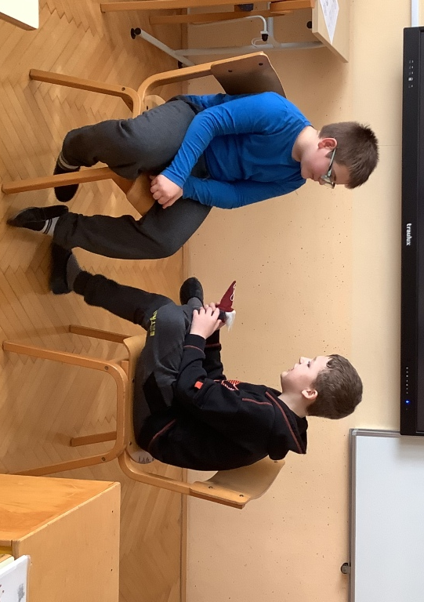
Resolving the conflict – A method “Litigare bene” (Dwarf-the-helper)
Pay attention to the position of body, especially feet.

Slide 27
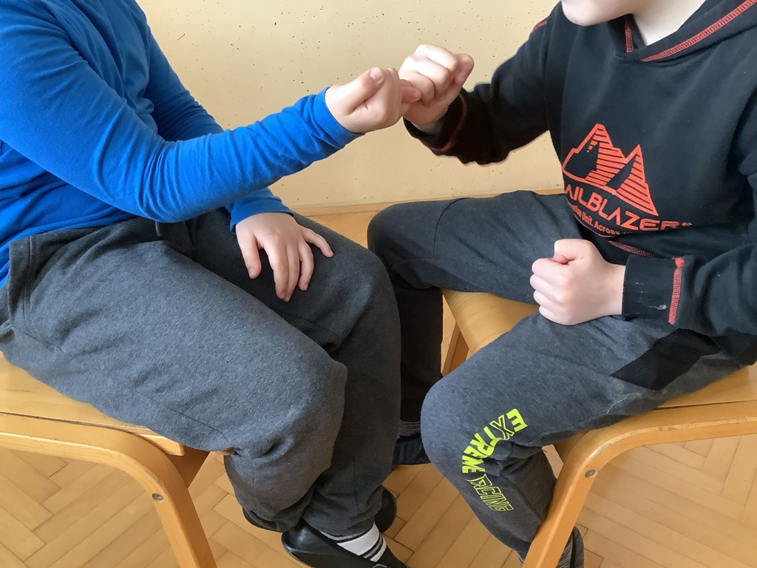
The students resolved their argument. Body language is stronger than words.

Slide 28
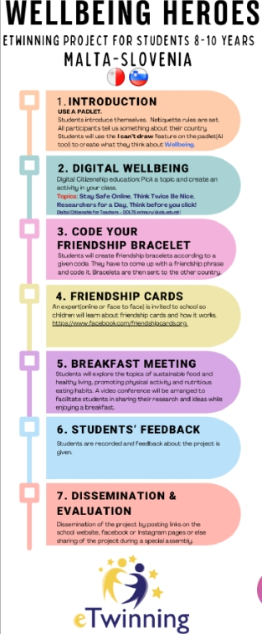
Activities with Friendship Cards

